Slide 1


DESIGN 1
Lesson 4: Formative: F1 Website with Images
Ms. Abboud • Grade 9 - Design 1 • Term 1, Week 6

Slide 2
Learning Objectives
WALT - We Are Learning To
WILF - What I'm Looking For
Show working links, navigation and images across the F1 website.
I insert images successfully.
I apply image attributes correctly.
I improve my webpage's appearance.

Slide 3
Frayer Model: Source (src) (Review)
DEFINITION
CHARACTERISTICS
The attribute on an <img> tag that tells the browser where to find the image file.
An attribute on <img>; holds the file path; required to show the image.
SOURCE (SRC)
EXAMPLES
NON-EXAMPLES
src="images/yas-marina-circuit.jpg"
alt (describes the image); href (used for links).

Slide 4
National Identity Integration
UAE Landmarks and Tourism: Yas Marina Circuit on Yas Island hosts the Abu Dhabi Grand Prix and welcomes visitors from around the world. Good images on a website help people picture a place before they visit.

Slide 5
STARTER
Spot the Bug
<img src="images/pit-stop" alt="Pit stop">
<img src="pit-stop.jpg"> (the file is in images/)
<img src="images/Pit-Stop.jpg" alt="Pit stop"> (the file is pit-stop.jpg)
Hook • Engage & Ask
5 - 10 minutes

Slide 6
LESSON CORE
I Do: The Formative and Rubric
Hyperlinks, Images & Tables Activities (10 pts): links and navigation 4, images 3, appearance 3.
Finish any missing images, then work through the Final Checklist.
Gradual Release of Responsibility
30 - 40 minutes
1 / 3

Slide 7
LESSON CORE
We Do: Stuck? Use the Example
Ask for the Example Code sheet and compare your code one line at a time.
Your alt text can be different, as long as it describes the picture.
Gradual Release of Responsibility
30 - 40 minutes
2 / 3

Slide 8
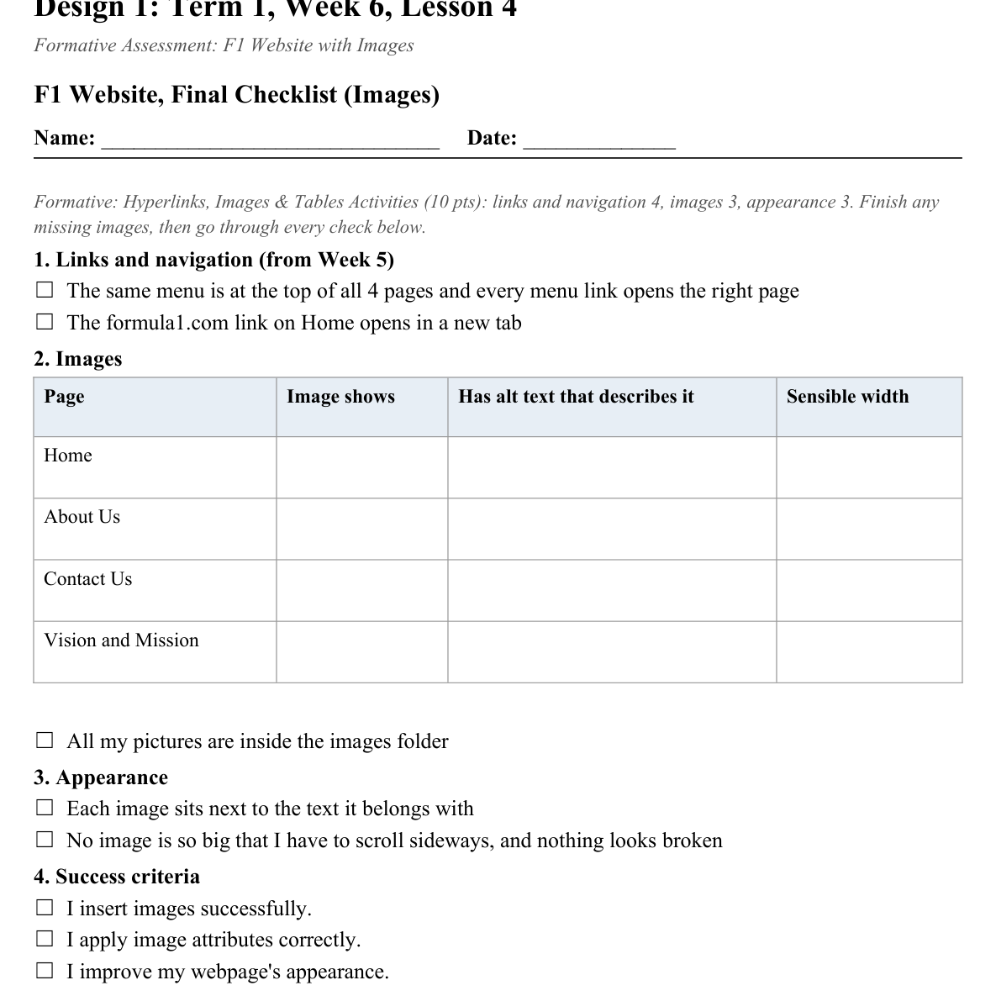
LESSON CORE
You Do: Finish, Check, Swap
Tick every item on the Final Checklist.
Peer test, fix what you find, then submit via Toddle.
Activity: F1 Website, Final Checklist (Images)
Gradual Release of Responsibility
30 - 40 minutes
3 / 3

Slide 9
CLOSURE
Exit Ticket
One thing about your F1 website you're proud of, one week before the mid-term break.
Transition & Extend
5 - 10 minutes

